Slide 1
Electrical and Computer Engineering
Graduate Program Director: Dr. Keith Schubert Graduate Program Coordinator: Mrs. Christy Londenberg

Slide 2
General Program Info

Slide 3
Key Takeaways:
Answer all emails from Christy Immediately!!!
Research degree students:
Find/meet your advisor YESTERDAY! You will not graduate unless you have an advisor to direct your research.
Think of grad school like an apprenticeship: the advisor is the ultimate authority on whether your work is acceptable and whether you eventually graduate. Taking/passing classes is not your primary objective!
Your research advisor is also your academic advisor (what classes to take, raising your registration flag each semester)
If you are funded:
Treat it like a job
Be at your desk or in lab when not in class
Plan ahead.
M.Eng. Students: I will be your academic advisor.

Slide 4
Grad desks in Rogers or BRIC (2110/2112)
PhD and MS students may ask for a desk in Rogers or BRIC
At either place, but not both.
Space in Rogers is very limited.
Communicate with me if you need a desk or if you need to move.
Some advisors have workspaces in their labs.
Temporary desk space avail for teaching purposes – email me
Department does not provide computers for grad students.

Slide 5
REQUIRED in ECE
Career Development
You must engage in at least one career development activity sponsored by the ECS career development office (Reina Wiseman) or BUGS each semester. Participation will be verified in order to renew your tuition remission for the following term.
ELC 5001 (eBEARS)
Required for all students on any level of scholarship (tuition and/or assistantship). Exceptions if you have moved away – contact Dr. Marks

Slide 6
Resources
BUGS
ATL
The Graduate Writing Center
contact Becca_Cassady@baylor.edu or gwc@baylor.edu.
Student Travel- Make sure to apply early at least 6 weeks
Health Insurance – Health Center, SLC, Online appointments
Counseling Center-Don’t wait too long to seek help
School Calendar
Science Careers myIDP

Slide 7
Academy for Teaching and Learning
Foundations for Teaching Workshop
What: A single-day workshop providing a basic toolkit for college teaching. Breakfast and lunch provided.
For more information and to register: https://atl.web.baylor.edu/ftw
Contact Dr. Christopher Richmann with any questions.
Foundations for Teaching LAB Workshop
What: A half-day workshop providing a basic toolkit for STEM lab teaching. Breakfast provided.
For more information and to register, click here. (Questions? Contact michelle_herridge@baylor.edu)
(limited to 45 participants)
EDL 6302: Teaching and Learning in Higher Education. All graduate students are eligible to register for this 3-credit course that explores the theory and practice of teaching in college settings. This course fulfils category 1 of TeaCHE. Questions? Contact christopher_richmann@baylor.edu).

Slide 8
English language skills
courses for international graduate students
GBL 5201 Teaching in English for International Teaching Assistants (ITAs) is a two credit-hour course focused on the classroom presentation and pronunciation skills necessary for ITAs to be successful in an American university classroom. Priority is given to international graduate teaching assistants, but the course is open to any international graduate student currently enrolled at Baylor, at no cost. Each student receives a weekly coaching session for individualized instruction. Contact Tanya Vernon for further information.
GBL 5103 English for Academic Purposes Graduate Writing is a one credit-hour course designed to help international graduate students develop skills in writing academic English. Students are provided opportunities to analyze and express ideas in academic texts while reading and critiquing the work of others. Students complete various assignments to become familiar with aspects of summarizing academic materials, synthesizing the existing research, describing their own research, and following field-specific citation guidelines to produce academic material. Contact Chris Fabiszewski for further information.

Slide 9
Graduate Assistants (GA)
Graduate students serving as TAs (teaching assistants)
Report to course professor
While assigned course
20 hrs/wk total on all courses
Summers
Act like RA
Typical duties:
Office hours (2+ hrs/wk)
Grading
Lab
TOR

Slide 10
Graduate Assistants (GA)
Graduate students serving as RAs (research assistants)
Report to advisor and work on projects assigned
While taking courses
20 hrs/wk and as needed for degree
Summers or during research
40 hrs/wk and as needed for degree

Slide 11
Where to find it
BEARWEB/IGNITE
Payroll stub (Ignite)
Yearly tax forms (Ignite)
Registering for classes (Bearweb)
Degree Audit (u.achieve)

Slide 12
Graduate Catalog Online
https://catalog.baylor.edu/graduate-school/
Add/Drop/Withdrawl/Cancellation:
https://catalog.baylor.edu/graduate-school/general-information/general-university-policies/cancellations-drops-university-withdrawals/
Transfer Credits
MS: https://catalog.baylor.edu/graduate-school/general-information/graduate-school-policies/masters-degrees-general-degree-requirements/
PhD https://catalog.baylor.edu/graduate-school/general-information/graduate-school-policies/doctoral-degrees-general-degree-requirements/
Programs offered
https://catalog.baylor.edu/graduate-school/curriculum-departments-institutes-instruction/school-engineering-computer-science/electrical-computer-engineering/#programstext

Slide 13
Responding to Emails
Student Travel
Health Insurance
School Calendar
The “V” class (variable)

Slide 14
Important Dates for Fall 2025
Date | Event
Aug. 26, 2025 | Truett Convocation
Aug. 27, 2025 | Last day for credit by examination
Aug. 29, 2025 | Last day to add/register for Fall semester
Sep. 10, 2025 | Last day to drop a course without a “W”
Oct. 1, 2025 | Graduation application deadline
Oct. 17, 2025 | Dissertation oral exam deadline
Oct. 27, 2025 | Dissertation submission deadline
Oct. 31, 2025 | Thesis oral exam deadline
Nov. 4, 2025 | Last day to drop/withdraw from university
Nov. 5–21, 2025 | Spring 2026 registration period
Dec. 1, 2025 | Deadline for non-thesis oral/comprehensive exams
Dec. 10, 2025 | Last day of classes
Dec. 12–17, 2025 | Final exams
Dec. 20, 2025 | Fall Commencement

Slide 15
Important Dates for Spring 2025
Date | Event
Jan. 13, 2026 | Last day for credit by examination
Jan. 15, 2026 | Martin Luther King Jr. Day (University closed)
Jan. 16, 2026 | Last day to add/register for Spring semester
Jan. 29, 2026 | Last day to drop a course without a “W”
Mar. 1, 2026 | Graduation application deadline
Mar. 6, 2026 | Dissertation oral exam deadline
Mar. 16, 2026 | Dissertation submission deadline
Mar. 20, 2026 | Thesis oral exam deadline
Mar. 27, 2026 | Last day to drop/withdraw from university
Apr. 6–24, 2026 | Summer and Fall 2026 registration period
Apr. 27, 2026 | Deadline for non-thesis oral/comprehensive exams
May 1, 2026 | Last day of classes
May 4–9, 2026 | Final exams
May 15–16, 2026 | Spring Commencement

Slide 16
PhD

Slide 17
Ph.D.
Preliminary Exam
1st year if have MS or equiv
Dissertation Defense
Yay!
2nd year otherwise
This is where you choose your dissertation committee
Dissertation Proposal
Research degree:
Work in lab for advisor
You should know your research advisor already!
If not, meet him/her today!
Take classes
36 hrs course
24 hrs 6v99
Produce research deliverables like papers, patents, artifacts
3 years (or 5) minimum
OPTIONAL: Enroll in 5397 the semester of your proposal. Successful proposal satisfies course requirement.

Slide 18
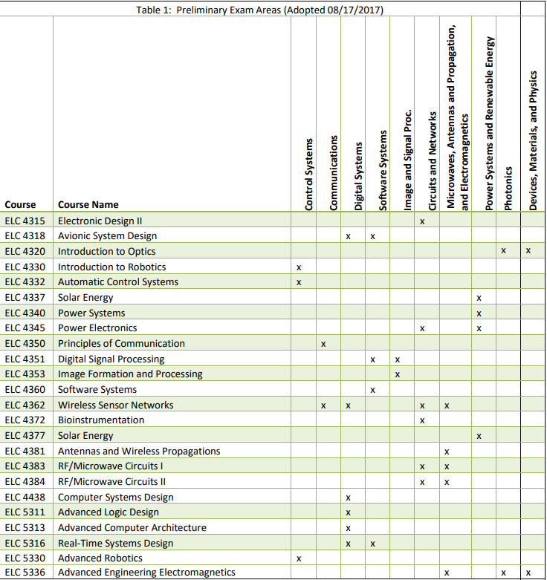
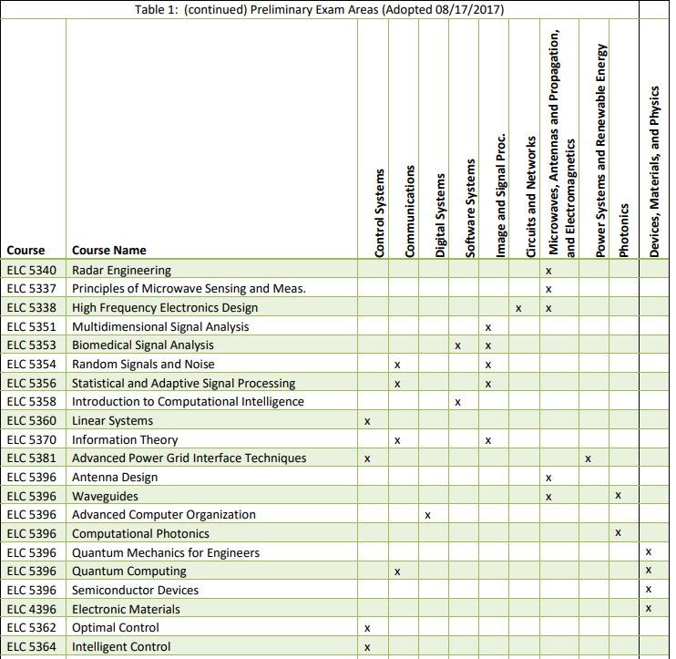

Slide 19
MS

Slide 20
M.S. Thesis
Work with advisor on research project
Thesis Defense
Research degree:
Work in lab
Work for advisor
Take classes
24 hrs courses
6 hrs 5v99
Produce research deliverables like papers, patents, artifacts
2 years typ
If you do not have a research advisor, it is IMPERATIVE to find one ASAP.

Slide 21
M.S. Project (non-thesis)
Work with advisor on project
Graduate
Work degree:
Project with advisor
Take classes
27 hrs courses
3 hrs 5397
Produce project deliverables
2 years typ
If you do not have a project advisor, it is IMPERATIVE to find one ASAP.

Slide 22
M.Eng.
Take classes (30 hours)
Graduate
Non-Research degree:
Unpaid
Take classes only (30 hours)
No thesis or research expectations
1.5 years typ
Industry does not distinguish between M.S. and M.Eng!

Slide 23
4+1 Accelerated BS/MS
B.S. with 2 overlap
Masters
Accelerated degree:
Undergrad and Grad
Varies by Masters
Recommend M.Eng
Overlap classes (6 hrs)
1 extra year typ
First 4 years are UG
UG financial aid
All subsequent are Grad
tuition discount
Can work on grant

